Slide 1

Business Analytics Capstone Framework for Strategy
Jagrit Dewan
Nov 4, 2020

Slide 2
Problem Statement– Describe the Problem Adblockers present to GYF
GYF is in extreme danger on losing billions of ad revenue given that its core businesses are search engine, digital media, and mail and chat.
Users don’t want to be constantly spammed with ads that are not relevant to their preferences/behaviors. They want uninterrupted user experience where their computer’s processing speed is not slowed and there aren’t any distractions on the websites they are browsing due to marketed advertisements.
Introduction of adblockers have provided users to have the user experience they desire without interruptions and distractions while at low to zero cost to them. This is where GYF’s ad revenue takes a beating as majority of the revenue for the company comes from marketing ads on its desktop and mobile digital platforms.
A potential prospect of marketing ads and generating ad revenue for GYF could have been through marketing on mobile apps but due to companies like Apple, introduction of mobile ad blockers poses a bigger threat for GYF’s main revenue stream and eventually its financial position within the industry.

Slide 3
Strategy

Slide 4
Strategy Describe your proposed strategy
Given the high use of social media and digital platforms, it is important to understand, assess and implement based on user’s preferences and tastes to have a successful strategy.
Firstly, it is important to ask the right questions: what type of products/services are in high demand? What is causing the users to adopt ad blockers? Are the current ads that are being marketed intrusive and irrelevant? Are the ads slowing down or interrupting user experience? What type of ads are users looking for? What type of user experience is the best?
The answers to these questions can be understood and assessed through exploratory, descriptive and causal research and by employing tools like surveys, focus groups, and social media analytics.
Based on the answers received and assessed for the questions above, it is important to understand all the technicalities of ad blockers to bypass them (by developing ad blocker proof websites much like Facebook does) and display ads that are non-intrusive and can add to the user experience which would eventually make users disable the ad blocker. (this is mostly for our desktop platforms) – it is also crucial to ask users to disable ad blockers for relevant ads for websites that can’t bypass the adblockers on our search engine.
For our mobile users: We should employ native advertising based on changing user preferences which is basically an integration of ads seamlessly into content much like TV ads which would be less interrupting for the user. Ensuring that the ads are directing users to the right pages/websites/apps remains crucial.
Allow companies to have access to our digital platforms for marketing advertisements on a subscription giving GYF a consistent flow of revenue regardless of how well the ads are doing on our platforms.

Slide 5
Effects and Measurement

Slide 6
Effects Describe the anticipated effects of your strategy
Since my strategy focuses on customers, GYF and our client base for marketing ads, it is important to consider the effects on all the three.
Given that we would be conducting in-depth analysis of users’ tastes and preferences through focus groups and surveys, we would get excellent insights on what consumers want to see and what type of ads they want to see. With this information, we would be able to better market the ads and collaborate with clients who have the same vision of improving consumer experience. The effects of this step of the strategy would be that users would not feel interrupted or disturbed while browsing through on our digital platforms and would keep loyal to us given the improved user experience.
This would mean that GYF now will be collaborating with sophisticated clients who also believe in improved user experience, allowing GYF to increase their ad revenue and develop strong client relationships that could be beneficial for business in the future. This will eventually result in higher ad revenue from our platforms.

Slide 7
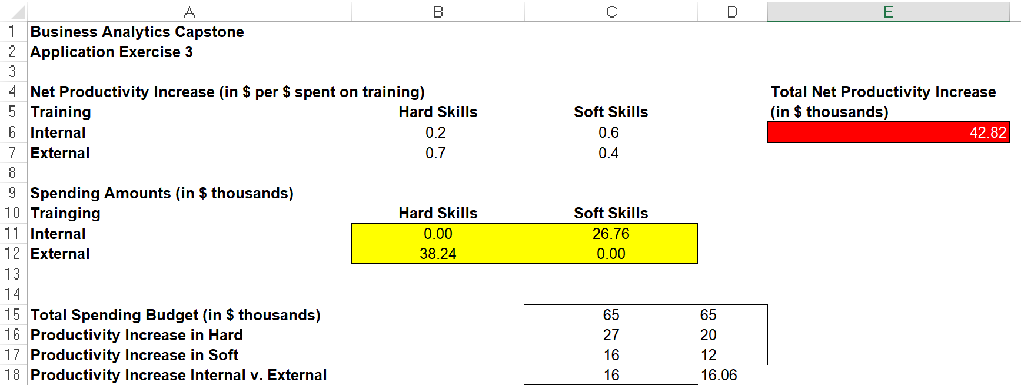
Effects Application Exercise 3 – Designing a Deterministic Optimization Model – to determine the right candidate for the new job
By using the scenario in the application exercise 3 – there are 4 decision variables: Budget for Hard/internal, budget for Hard/external, budget for Soft/Internal, and budget for Soft/external.
Objective function would be the sum product of these 4 variables with the corresponding net productivity value for each decision variable.
Formula for constraint, ‘productivity increase in hard; =SUMPRODUCT(B11:B12,B6:B7) for cell c16
Formula for constraint, ‘productivity increase in soft; =SUMPRODUCT(C11:C12,C6:C7) for cell c17
Formula for constraint, ‘productivity increase internal v. external; =SUMPRODUCT(B11:C11,B6:C6) for cell c18 and =0.6*SUMPRODUCT(B12:C12,B7:C7) for cell d18
The total net productivity increase is $42.82 ($ in thousands).

Slide 8
Measurement Describe the anticipated effects of your strategy and how you will measure them
It is important to consider metrics like size of the client base before and after implementing the strategy, customer count before and after and their user experience, and ad revenue before and after.
All these metrics require data to be good measurement metrics for our strategy. Data will include customer surveys, focus groups, ad revenue before and after strategy implementation, and customer count before and after implementation. All of these are non-intuitive based metrics and will require in-depth data analysis to predict performance and evaluate performance of the strategy.
Focus groups and surveys will be done using users who would get incentives to participate in them thus engaging and attracting more users.
Customer base and client base can be evaluated through our internal ERP solutions like Customer relationship management systems.
User experience can be evaluated by again conducting surveys. These surveys could help us understand what type of user experience they are looking for and eventually we can further improve the type of clients we work with and how we market ads for our clients.

Slide 9
Measurement Application Exercise 4 – Identifying Key Drivers
Hypothesis: understanding, assessing and implementing ads based on user’s preferences and tastes will help us to increase ad revenue from our platforms because we would be displaying ads that will be relevant and non-intrusive. Having relevant and non-intrusive ads will help GYF to retain users on our digital platforms and acquire more clients that would want to market their products/services on our platforms.
Key drivers: one key driver to measure whether our non-intrusive ads are retaining customers is to assess the number of customers on our platforms before this implemented strategy and after 6 months of this strategy being implemented. If there is no change or a positive change – we can confirm that our ads are doing well.
Linkages: key drivers like customer count, increased client base and increased ad revenue are all indicative of the causal business model where we are assessing how well our strategy is working based on metrics like customer retention and acquisition, ad revenue, and client base. All these drivers provide a good and direct measurement system to evaluate our strategy. If there is an increase in ad revenue, is there an increase in our client base as well? – These are the type of linkages that we would have to assess. Non-financial measures like customer satisfaction and customer engagement can also be used to evaluate the success of the strategy.

